Slide 1

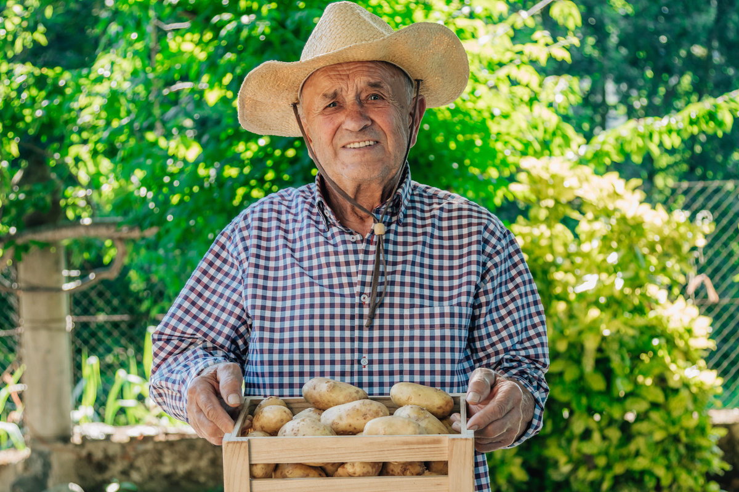
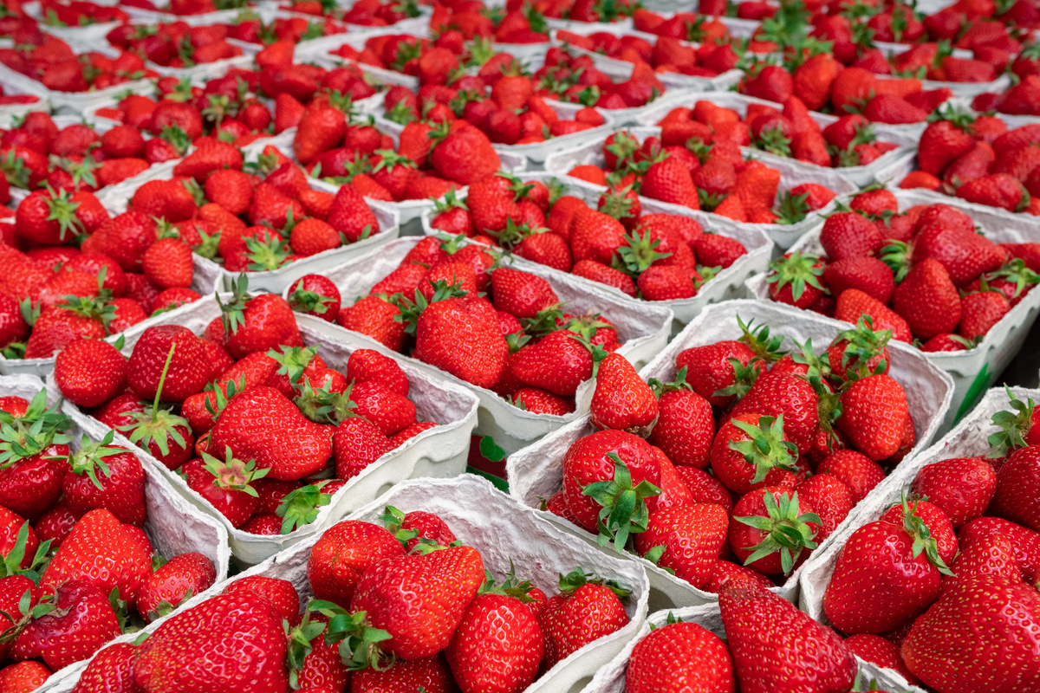



PRODUCER
SPOTLIGHT
*name here*
*farm name here*
ABOUT PRODUCER
*Insert biography or summary about producer here*
*Insert contact/location information about the producer here*
ABOUT FARM
*Insert producer’s farming mission here*
  *Insert information about farm type here*
  *Insert information about crops here*
  *Insert information about crops here*
Fraud Hotline: 1-866-5-FRAUD-4 or 1-866-537-2834 | P.O Box 12847 | Austin, TX 78711
Toll Free: (877) TEX- MEAL | For the hearing impaired: (800) 735-2989 (TTY)
Food and Nutrition Division
Fresh Fruit and Vegetable Program
This product was funded by USDA.
This institution is an equal opportunity provider.
Updated 2/26/2024
www.SquareMeals.org

Slide 2

PRODUCER
SPOTLIGHT
*name here*
*farm name here*
ABOUT PRODUCER
*Insert biography or summary about producer here*
*Insert contact/location information about the producer here*
ABOUT FARM
*Insert producer’s farming mission here*
  *Insert information about farm type here*
  *Insert information about crops here*
  *Insert information about crops here*
Fraud Hotline: 1-866-5-FRAUD-4 or 1-866-537-2834 | P.O Box 12847 | Austin, TX 78711
Toll Free: (877) TEX- MEAL | For the hearing impaired: (800) 735-2989 (TTY)
Food and Nutrition Division
Fresh Fruit and Vegetable Program
This product was funded by USDA.
This institution is an equal opportunity provider.
Updated 2/26/2024
www.SquareMeals.org

Slide 3

VEGETABLE
SPOTLIGHT
*veggie*
Local produce supports community sustainability and provides fresher, healthier options while cutting transportation emissions.
ABOUT *VEGGIE*
*Insert brief description of veggie and its nutritional benefits here*
GARDEN GIGGLES
*PRODUCER NAME*
  *Insert fun fact/ fun activity with veggie here*
*Insert brief info of producer here*
*Insert where producer grows/supplies fruit here*
  *Insert fun fact/ fun activity with veggie here*
Fraud Hotline: 1-866-5-FRAUD-4 or 1-866-537-2834 | P.O Box 12847 | Austin, TX 78711
Toll Free: (877) TEX- MEAL | For the hearing impaired: (800) 735-2989 (TTY)
Food and Nutrition Division
Fresh Fruit and Vegetable Program
This product was funded by USDA.
This institution is an equal opportunity provider.
Updated 2/26/2024
www.SquareMeals.org

Slide 4
VEGETABLE
SPOTLIGHT
*veggie*
Local produce supports community sustainability and provides fresher, healthier options while cutting transportation emissions.
ABOUT *VEGGIE*
*Insert brief description of veggie and its nutritional benefits here*
GARDEN GIGGLES
*PRODUCER NAME*
  *Insert fun fact/ fun activity with veggie here*
*Insert brief info of producer here*
*Insert where producer grows/supplies fruit here*
  *Insert fun fact/ fun activity with veggie here*
Fraud Hotline: 1-866-5-FRAUD-4 or 1-866-537-2834 | P.O Box 12847 | Austin, TX 78711
Toll Free: (877) TEX- MEAL | For the hearing impaired: (800) 735-2989 (TTY)
Food and Nutrition Division
Fresh Fruit and Vegetable Program
This product was funded by USDA.
This institution is an equal opportunity provider.
Updated 2/26/2024
www.SquareMeals.org

Slide 5
FRUIT
SPOTLIGHT
*fruit here*
Local produce supports community sustainability and provides fresher, healthier options while cutting transportation emissions.
ABOUT *FRUIT*
*Insert brief description of veggie and its nutritional benefits here*
GARDEN GIGGLES
*PRODUCER NAME*
  *Insert fun fact/ fun activity with fruit here*
*Insert brief info of producer here*
*Insert where producer grows/supplies fruit here*
  *Insert fun fact/ fun activity with fruit here*
Fraud Hotline: 1-866-5-FRAUD-4 or 1-866-537-2834 | P.O Box 12847 | Austin, TX 78711
Toll Free: (877) TEX- MEAL | For the hearing impaired: (800) 735-2989 (TTY)
Food and Nutrition Division
Fresh Fruit and Vegetable Program
This product was funded by USDA.
This institution is an equal opportunity provider.
Updated 2/26/2024
www.SquareMeals.org

Slide 6
FRUIT
SPOTLIGHT
*fruit here*
Local produce supports community sustainability and provides fresher, healthier options while cutting transportation emissions.
ABOUT *FRUIT*
*Insert brief description of veggie and its nutritional benefits here*
GARDEN GIGGLES
*PRODUCER NAME*
  *Insert fun fact/ fun activity with fruit here*
*Insert brief info of producer here*
*Insert where producer grows/supplies fruit here*
  *Insert fun fact/ fun activity with fruit here*
Fraud Hotline: 1-866-5-FRAUD-4 or 1-866-537-2834 | P.O Box 12847 | Austin, TX 78711
Toll Free: (877) TEX- MEAL | For the hearing impaired: (800) 735-2989 (TTY)
Food and Nutrition Division
Fresh Fruit and Vegetable Program
This product was funded by USDA.
This institution is an equal opportunity provider.
Updated 2/26/2024
www.SquareMeals.org

